Slide 1
The people who are making it possible

Slide 2
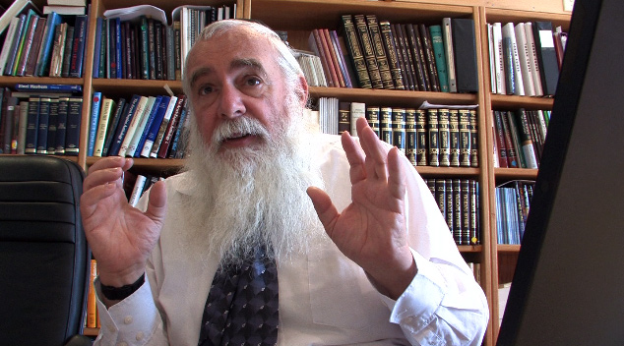
the world experts
Professor Eliyahu Rips
Considered the discoverer of the Torah Code, professor Rips is a world-class mathematician in the area of Group Theory.
Rips was the first to have the idea to search the Torah with a computer in the 80’s, along with Witztum and Rosenberg. Their findings shocked the scientific community. Rips today continues his research with new revelations creating even more undeniable proof that the Code exists.

Slide 3
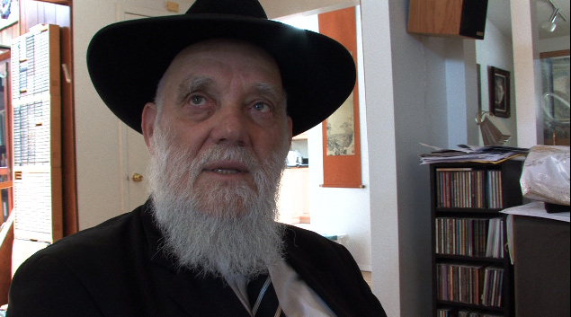
the world experts
Rabbi Matityahu Glazerson
Rabbi Glazerson is author of over 25 books with extensive knowledge in the Torah, the Kabbalah and the Torah Codes.
Many of the most startling new Codes have been found by Rabbi Glazerson. His depth of study into ancient texts and their meaning adds tremendous insight into the topics of the Mayan calendar and 2012.

Slide 4
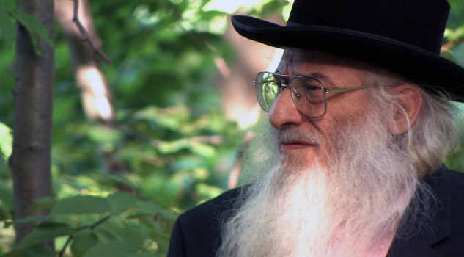
the world experts
Professor Robert Haralick
The distinguished professor of Computer Science for the City University of New York. His area of expertise includes image processing, computer vision, and pattern recognition. He has published over 550 archival articles and is listed in the Marquis' Who's Who in the World.
Dr. Haralick has become the determining factor in checking the accuracy of new Code findings. His protocols, experiments and software are used to test and determine the statistical significance of a Table. Using up to 10,000 other “monkey texts” for scientific comparison, when Dr. Haralick says it’s a 1.5 chance in 10,000, he means it.

Slide 5
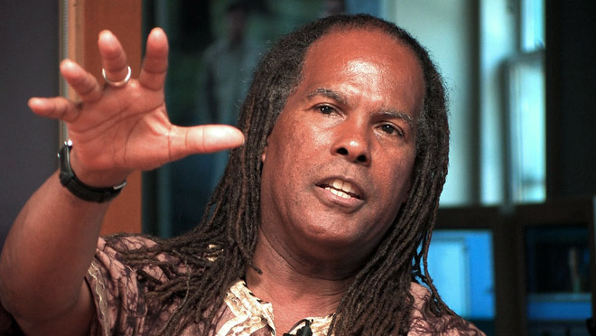
the world experts
Michael Bernard Beckwith
Referred to by Larry King as “Oprah’s spiritual advisor,” Michael Beckwith has become a national figure in the area of consciousness and spiritual insight.
He is well known for his appearance in “The Secret,” and has written several books including his most recent best-seller, “Spiritual Liberation.” Michael is the leader of the Agape International Spiritual Center in Culver City CA, an org with 8,000 members. Michael Beckwith’s views on how we may be affected by the Torah Codes and 2012 will thread throughout the program.

Slide 6
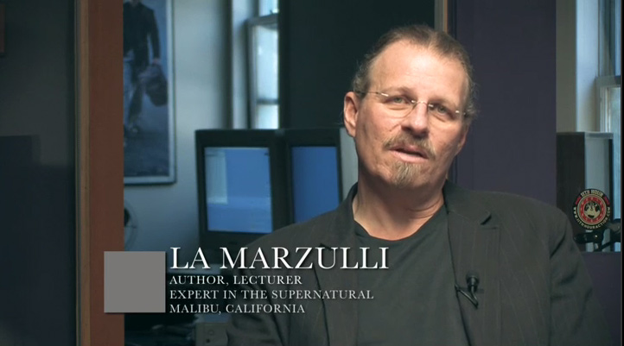
the world experts
LA Marzulli
Author, lecturer LA Marzulli is a favorite on Coast to Coast AM. His book “Politics Prophecy and the Supernatural” takes a serious view on today’s events unfolding in the world. His depth of study in the Old Testament and other ancient texts reveal how well the Torah Codes fit in to prophecies that we are currently experiencing.
LA Marzulli received an honorary doctorate for his books on the Nephilim and he is also an expert on UFOs.

Slide 7
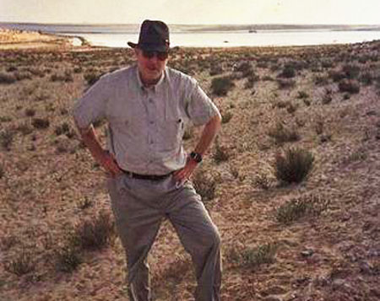
the world experts
Barry Roffman is a Torah Code researcher who is a retired U.S. Coast Guard officer.
His Code studies focus on maps found in the Torah that link Temple Mount to a site in Egypt where he believes the Ark of the Covenant will be found. On these maps, Jerusalem and geographic sites (including an important Egyptian fortress, Baal Zephon) were found encoded at angles to each other that match actual relevant course headings.
Roffman’s Code studies also cover major world and supernatural events. He combines standard scientific methods with Codes to investigate UFOs, Anti-gravity and Time .
Barry Roffman

Slide 8
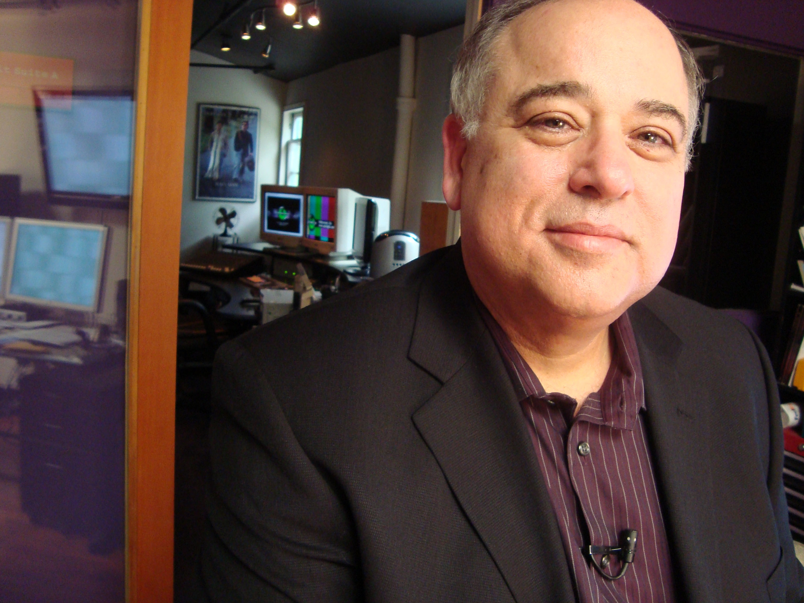
ON 2012
Marshall Masters
Marshall Masters, former Science Producer for CNN, decided to study Global Warming. His findings led him to the events predicted by the Mayan Calendar in 2012. His attention was drawn to the fact that other planets in our solar system were also experiencing various changes. Could another planetary body be entering our system?
Marshall Masters has become the expert on Planet X. His YouTube videos have garnered millions of hits and he is also the publisher of the Kolbrin Bible, an ancient Egyptian text.

Slide 9
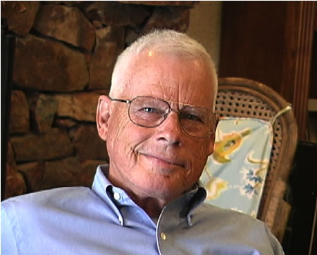
ON 2012
John Lear
John Lear is the son of the famous inventor of the Lear Jet. He is a Lockheed L-1011 Captain and is highly regarded in aviation circles. He has flown over 150 test aircraft and has won every award granted by the Federal Aviation Administration. John also holds 18 world speed records and has worked for 28 different Aircraft Corporations.
During the late 1980s and early 1990s, John began coming forward with some startling revelations concerning the subject of aerial phenomena and Unidentified Flying Objects. Why are there now crop circles depicting 2012 graphics and solar system data?

Slide 10
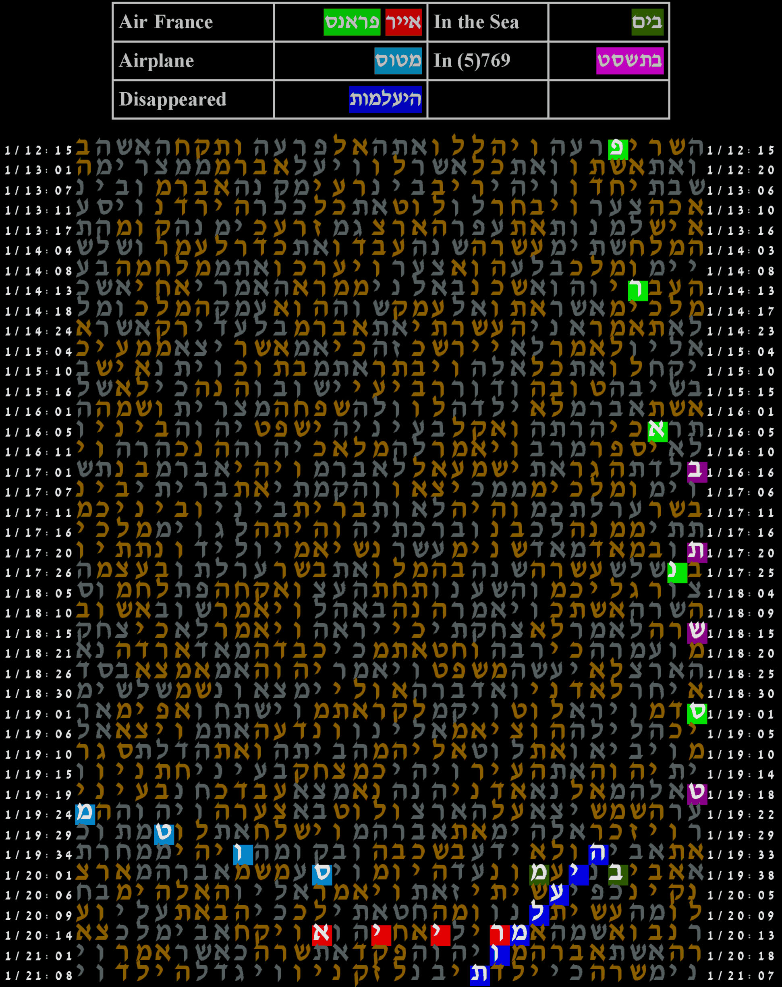
Projected Additional Speakers
Art Levitt — Torah Code expert
Dr. Moshe Katz — Torah Code expert
Gregg Braden — 2012 Expert
John Major Jenkins — 2012 Expert
Walter Cruttenden — Binary Sun studies
Christopher Jacobs — JPL Scientist, interferonomy
Harold Gans — Code breaker, DOD and NSA
Rabbi Yitz Jacobs — Instructor, Torah Codes, AISH LA
Michael Drosnin — Author best selling book, The Bible Code
Stanton Friedman — nuclear physicist, professional ufologist
George Noory — Host of the nationally syndicated program, Coast to Coast AM

Slide 11
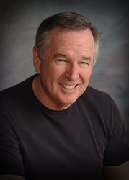
PRODUCTION
Dan Gordon (Playwright) is a master storyteller who creates indelible characters and relationships, which have afforded actors the opportunity to play some of their most unforgettable roles.
In the recent fighting between Israel and Hezbollah, he served as a Captain (Res.) in the Israel Defense Forces Military Spokesperson Unit. His film credits include The Hurricane, which starred Denzel Washington, Wyatt Earp with Kevin Costner, The Assignment with Sir Ben Kingsley, Murder in The First with Kevin Bacon, andPassenger 57 with Wesley Snipes.
Writer: Dan Gordon

Slide 12
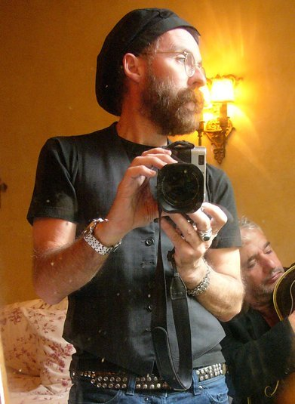
PRODUCTION
Lee Cantelon began producing weekly television series for French and Belgian television in his early 20's. He went on to work for many of the European networks, including Channel 4, the RAI, and the BBC.
Cantelon is also known for his photography, most notably his documenting of the Rwanda conflict in 1994. In the 1990's he authored a book that reexamines the teachings of Jesus (The Words). Research for The Words took him to Israel to the Hebrew University, and later encounters with many of the key figures who figure in the Torah Code work.
Co-Producer: Lee Cantelon

Slide 13
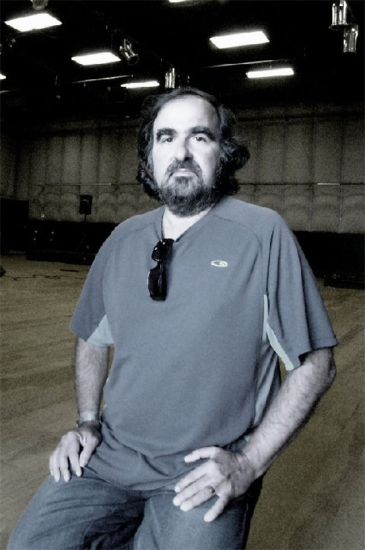
PRODUCTION
Richard Shaw is nationally known as an industry specialist in the field of digital non-linear editing and emerging technologies. His television and film career together spans three decades. He was a writer for 15 years in numerous industry magazines on digital audio, music, sound design, digital SD and HD video.
Shaw co-produced Beat the Drum, winner of 30 International Awards, distributed by MGM and Kimmel International. He was director/editor for The Wordz Project film. Currently, Richard is president of Pinlight LLC in Hollywood and is the creator of the Torah Code and 2012 documentary project. www.pinlight.com
Producer/Director: Richard Shaw

Slide 14
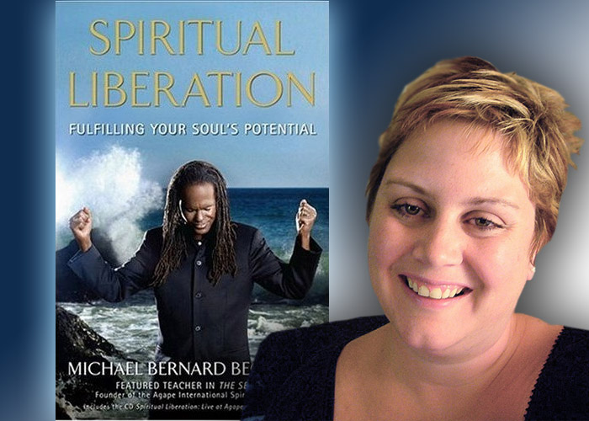
PUBLICITY DIRECTOR
Courtney Dunham is the publicity director for The Torah Code and 2012.
Before starting her own publicity company, Dunham Media, she was the publicity director for the multi-media publisher of The Secret, which has sold more than 7 million copies. Courtney went on to be the publicist for Michael Bernard Beckwith, who was featured on Oprah twice and Larry King Live numerous times. Along with her proven track record in the mainstream media, Courtney also brings more than 10 years of experience in journalism as a managing editor and columnist. She knows how to get a story into the media because she was the media.
DUNHAM MEDIA
Publicity & Representation

Slide 15
BUSINESS & WEB
Filmmakers Russ McDonald and Rob Netherland have taken on several movie projects this year. The Torah Code and 2012 was quite fascinating to them, and they are our business plan providers.
Beyond that Russ will be building a website for us. Dramatic, with a movie-like feel, the website will provide PPV streaming media of the finished documentary, as well as a way for DVD sales to be handled via e-commerce. Ancillary products and an international database can also be acquired once we’re up and running.
Russ McDonald
Rob Netherland

